Slide 1
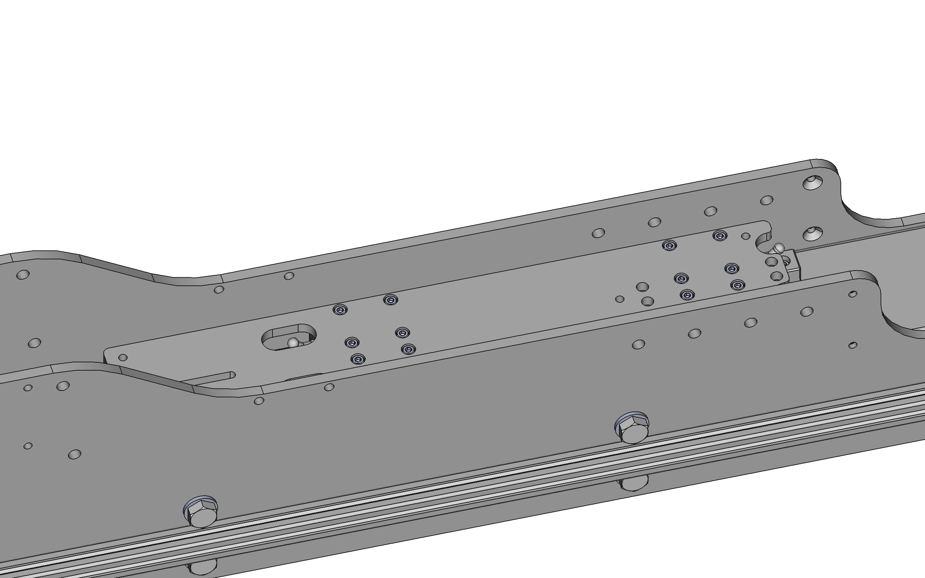
First loosely fit coupling plate to carriages
Then use a dial test indicator attached to instrument frame and probe against an edge of coupling plate (whilst sliding the coupling plate) to align it parallel to the rails, before tightening screws

Slide 2
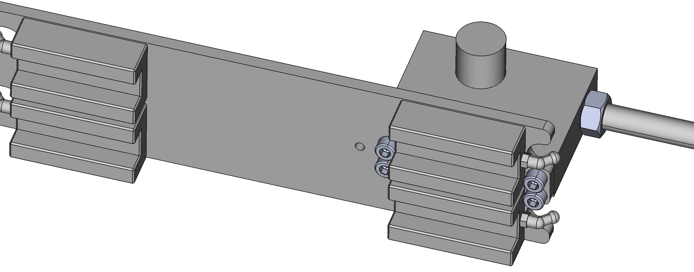
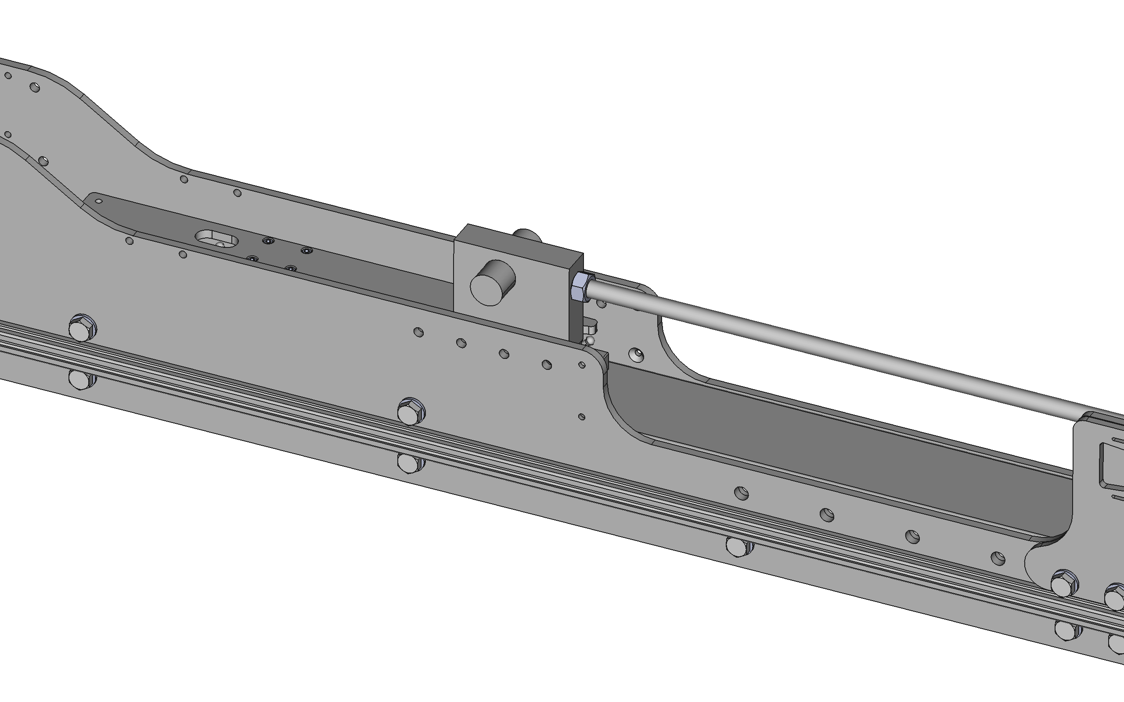
First fit threaded bar and loosely attach coupling block with associated mounting screws
Then use dial test indicator attached to instrument frame, probing against threaded bar, to rotationally align coupling block by gently tapping the bar, before gently removing the assembly and tightening mounting screws

Slide 3
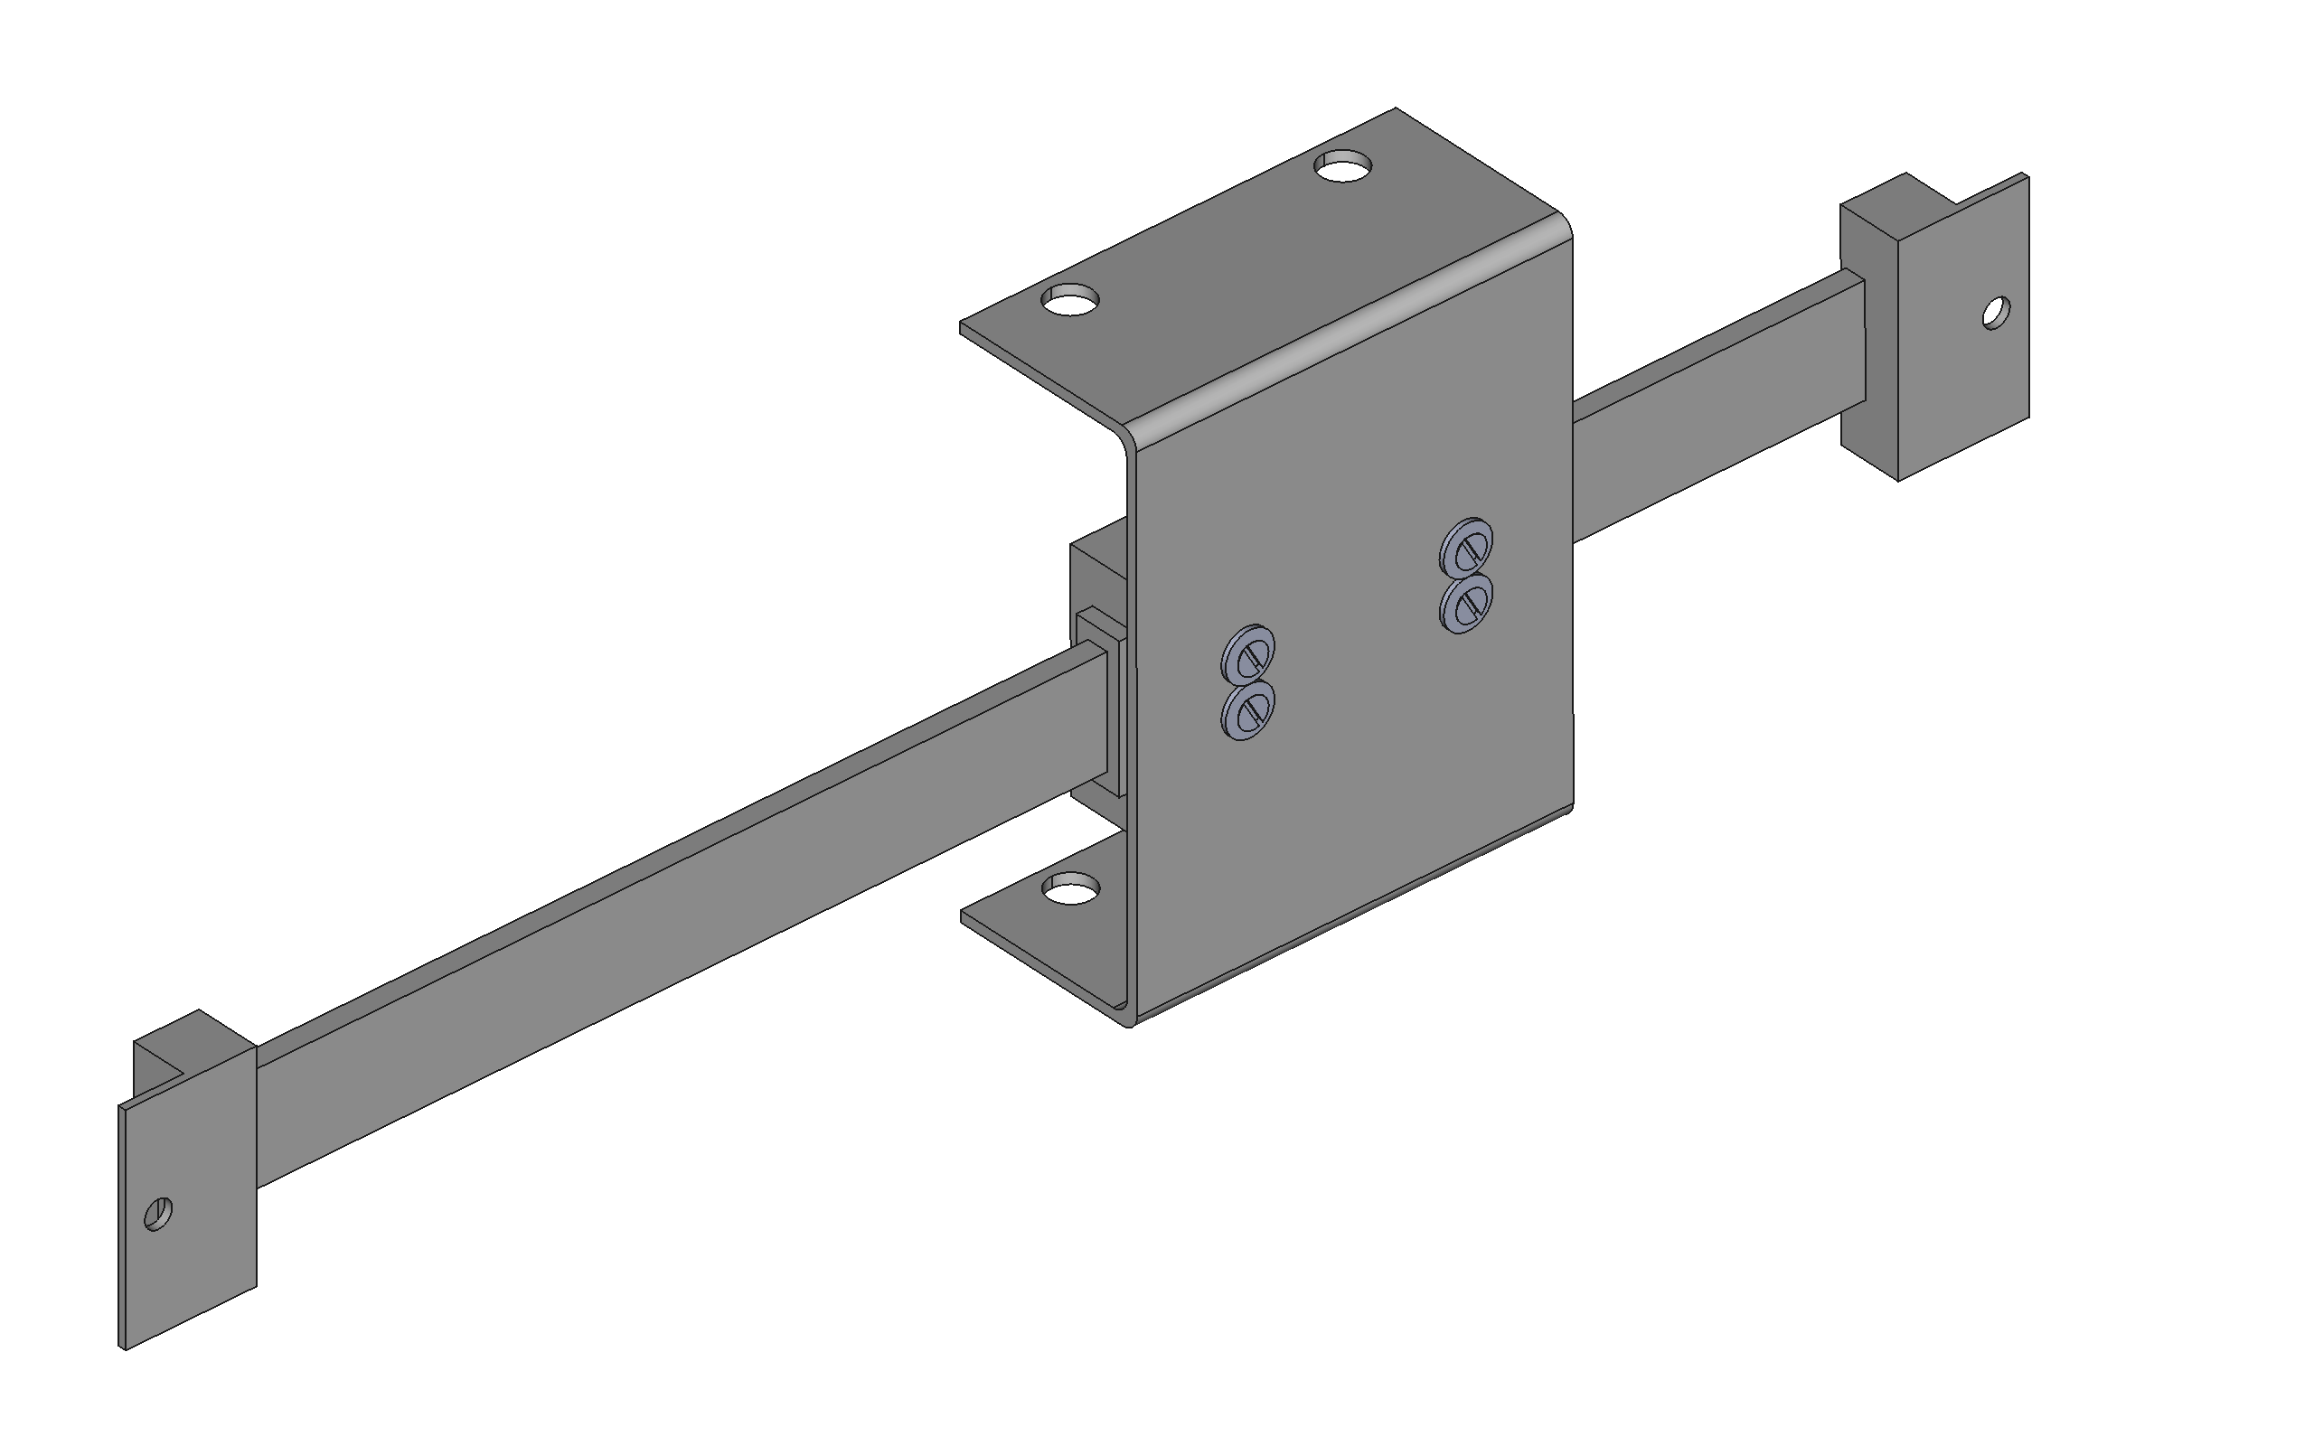
Linear scale body attached with M3 countersunk screws and M4 washers to bracket
Align rail parallel to sides of mounting bracket and centred across bracket – check squareness and centring using opposite side of mounting bracket (folded bracket may not be precisely square)

Slide 4
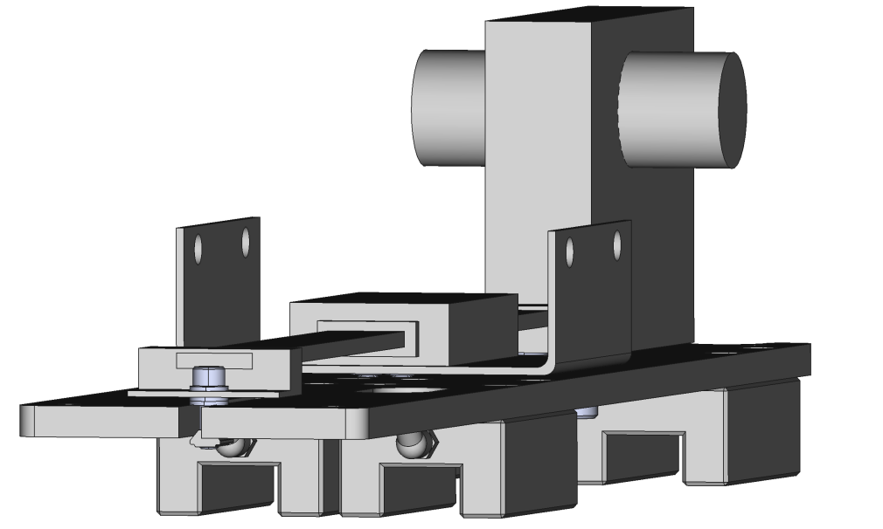
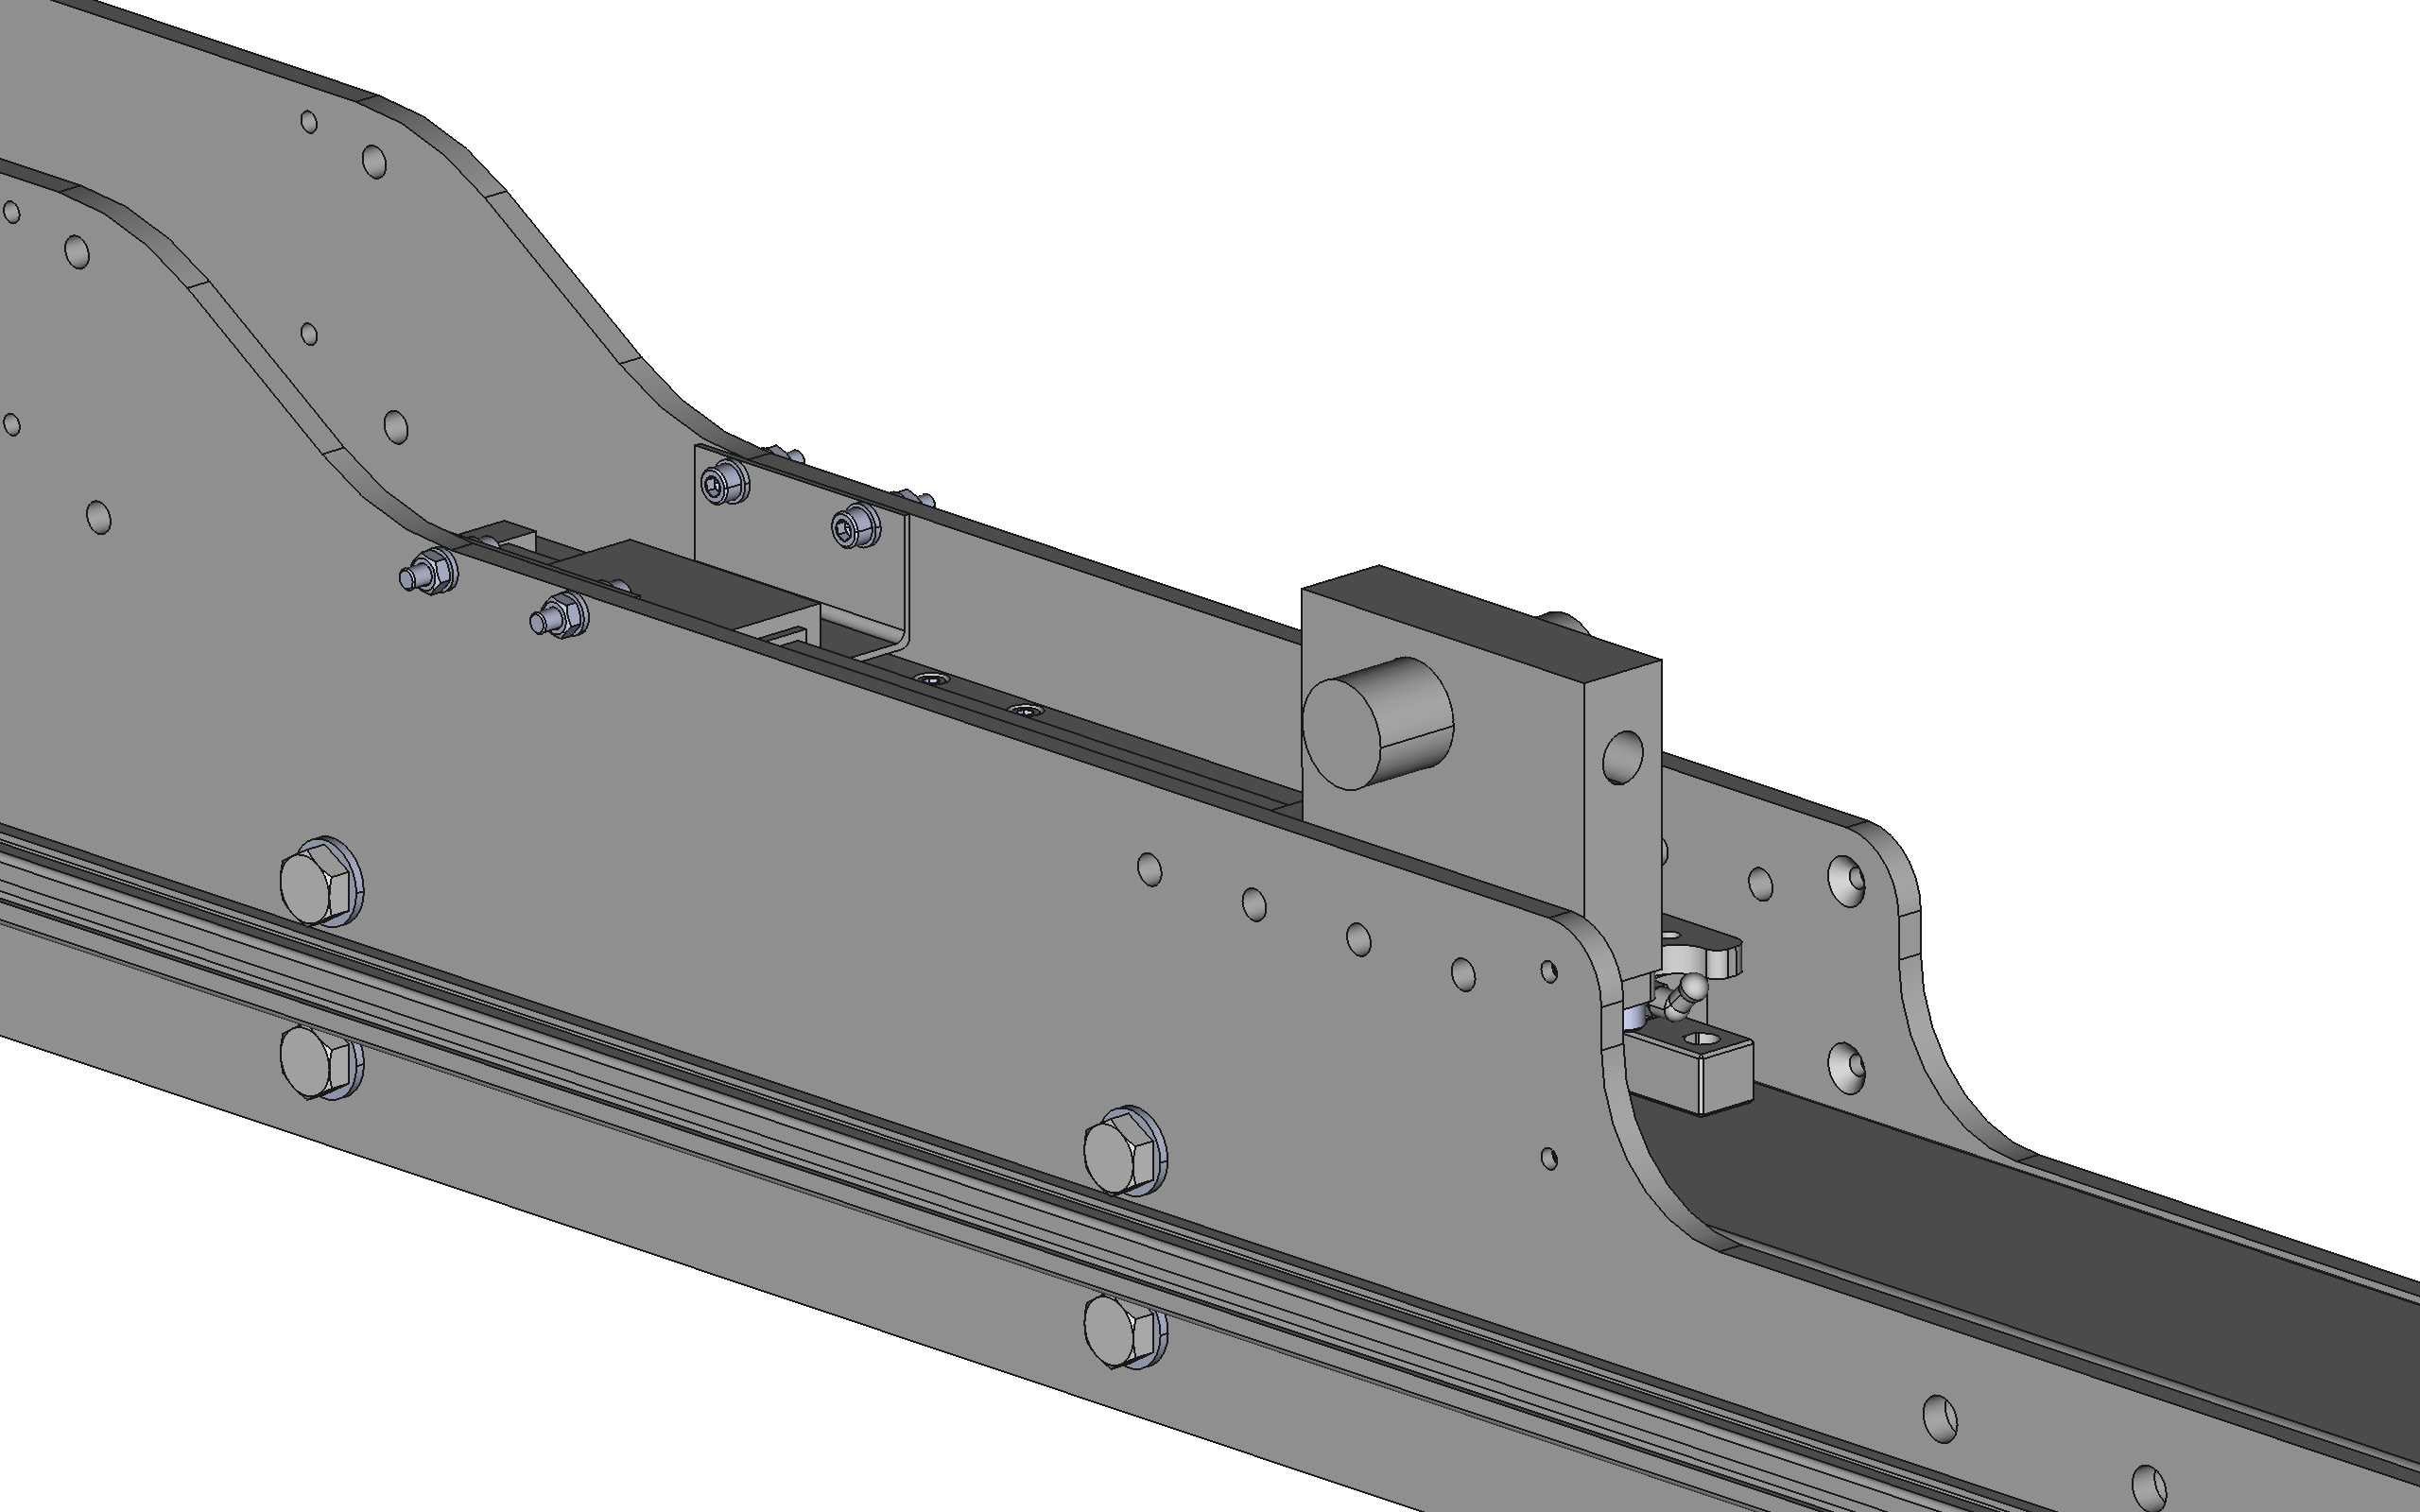
Linear scale rail spaced by ~2x M5 washers at both ends. Rail nut used in slotted plate end, opposite end is a tapped hole
Linear scale bracket attaches using holes in instrument side plates

Slide 5
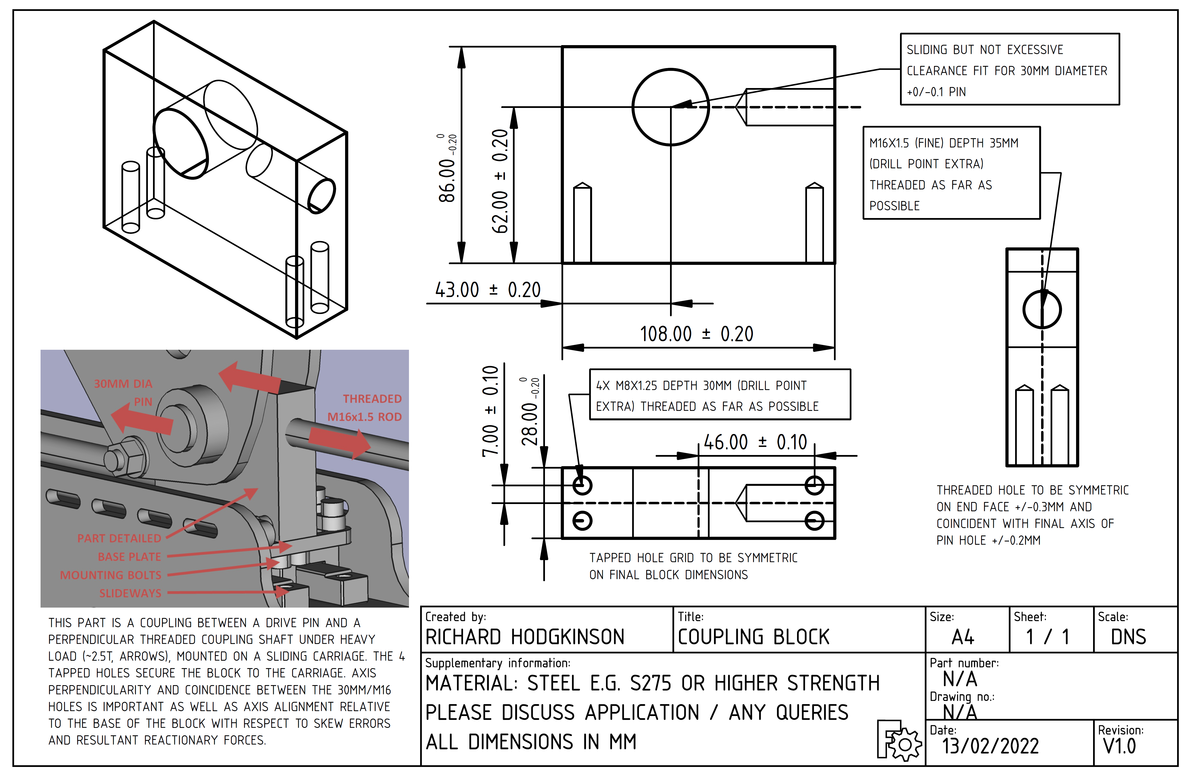
LINK – CLICK TO OPEN/DOWNLOAD FILE

